Slide 1

Visualizing the Effects of Cancer to Poverty in Excel, Python, and RStudio
Tameka Gillett

Slide 2
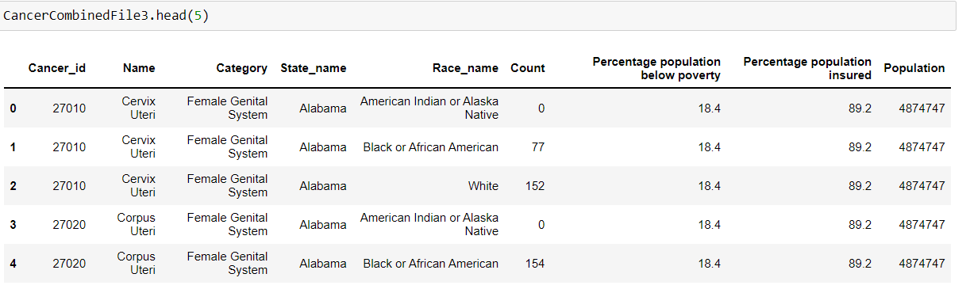
Original Data Set

Slide 3
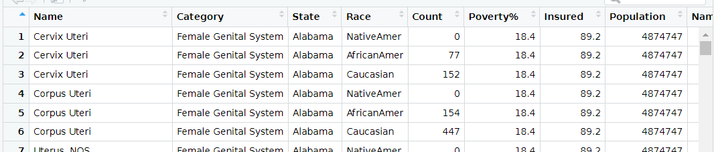
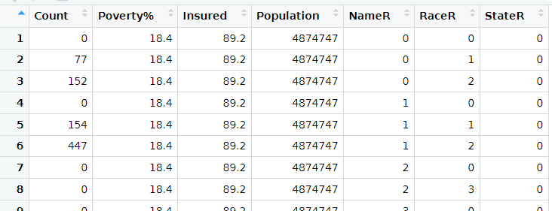
Transformations

Slide 4
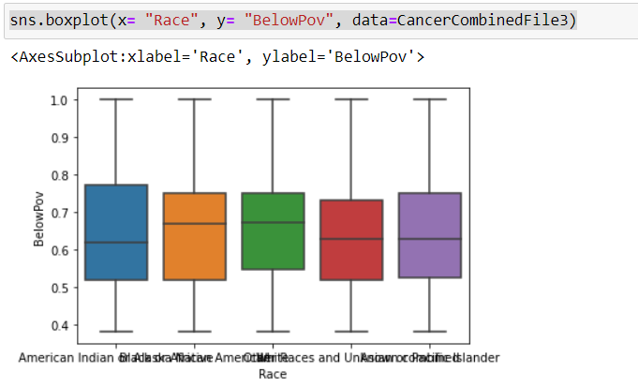
Boxplot of Race to % of Pop in Poverty

Slide 5
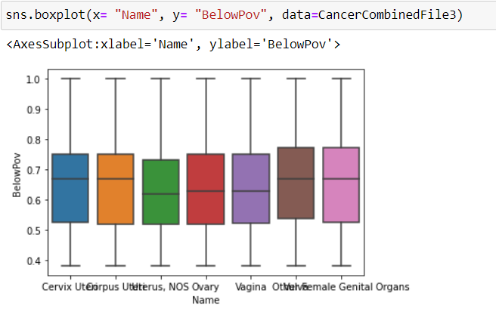
Cancer Type to % of Pop in Poverty

Slide 6
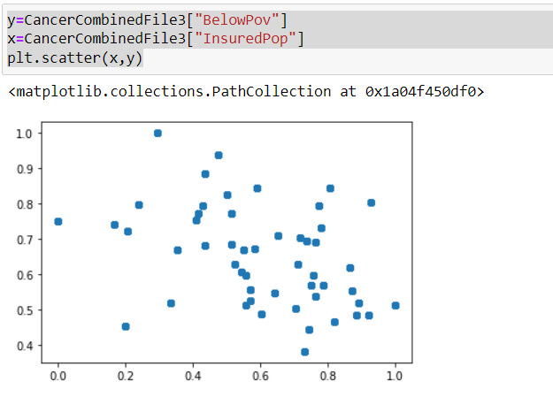
Populations Below Poverty vs Insured
There are many outliers being expressed here which could assist in creating a linear regression model to express forecasting for the different populations in reference to cancer development.

Slide 7
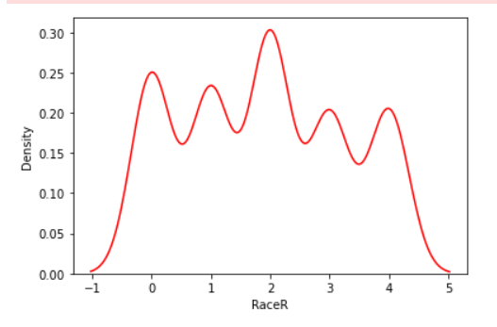
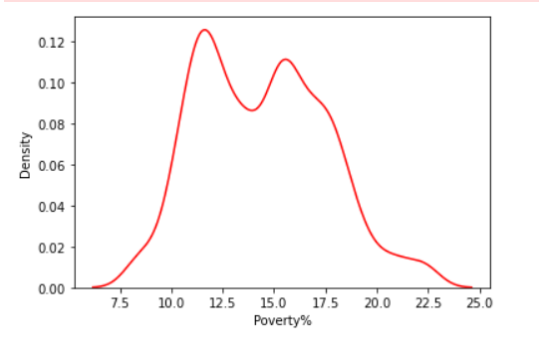
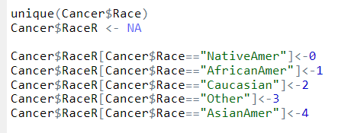
Race in Comparison to Pop % in Poverty
It is expressed that due to the large difference in the Caucasian population to the others, the data is skewed.
Their data, in comparison to the other races, would need to be compared separately in order to accurately compare which races are affected more by the populations in poverty and which have specific pulls toward specific cancer types.

